Slide 1
Safety Moments
From H&P

Slide 2


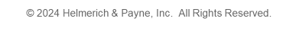
™
Take Safety Home
This holiday season, bring home questions, stories & create a foundation for an Actively CAREing culture at home
We Actively C.A.R.E. for those around us everyday, but when we go home, do we actively talk to our family and look for ways to mitigate safety exposures they may face? Are we creating a safety-focused culture at home?
Click through for safety topics to discuss with your loved ones
What if this holiday season, you shared the culture that we as an industry live by everyday with your loved ones? Take the time to ask the right questions and have an open dialogue. Never assume “they know better”.

Slide 3
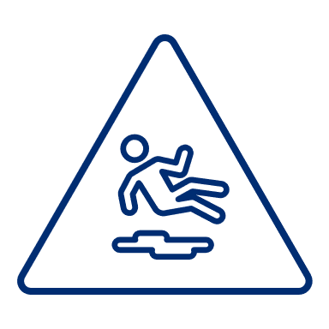
Falls From Heights
Falls are one of our greatest exposures in O&G and can have life altering implications. Falls are also the most common cause of household injuries and is the second most common cause of fatal accidents at the home.
Have you shared the importance of being tied off when at heights or what actions to take if they see someone fall?
Understanding Ladder Safety
  Ensure that the ladder is on a firm, even surface and that its fully open with all locks securely in place.
  Use a 3-point contact rule: Either keep two hands and one foot, or two feet and one hand on the ladder at all times.
  Don't Overreach: Move the ladder instead of leaning too far to one side. Overreaching can make the ladder unstable and cause it to tip.
Recognizing Hazardous Situations
  Awareness is critical. Talk to your family about identifying unsafe practices so they will recognize risky situations when they see one. It’s a great opportunity to talk about the importance of speaking up.
What To Do If You See a Fall
  Let kids know to get help from an adult right away if they see a fall or something dangerous. Talk to adults about a plan of action. Having a plan helps prevent panic.
Create a Culture of Safety
  Share why safety rules like tying off aren’t just “work rules”, they’re practices that protect everyone.

Slide 4

Safe Driving
Motor vehicle accidents continue to be our greatest off-the-job exposure. 80% of crashes are the result of distracted driving and using a cell phone while driving makes you 4X more likely to be involved in a collision.
Always Buckle Up: Reinforce that seatbelts are non-negotiable for everyone in the car, every time
Stay Alert: Distractions can be deadly. Whatever someone texted you while driving can wait
Plan the Trip: Explain journey management—mapping out rest stops and avoiding driving when fatigued
Watch Out for Wet/Icy Roads: Does your family know that using cruise control in rainy or slick conditions is dangerous? What else should they know?

Slide 5

Emergency Procedures
We have procedures for handling emergencies or incidents on the rig and in the office, but does your family have emergency procedures in place? Below are a few to consider.
Meeting Spot if Separated:
  Decide on a safe place to meet in case you get separated
Emergency Contacts:
  Know who to call first in an emergency. Have them written down and easily accessible.
Fire Extinguisher Locations:
  Make sure everyone knows where the fire extinguishers are in the house and how to use them
Severe Weather Plan:
  Review where to go and what to do if severe weather like a tornado or hurricane occurs. Have water & supplies stashed and ready.

Slide 6

Talk to Your Kids
For parents, keeping our kids safe is paramount, but we must also remember to instill in them the tools and knowledge to help keep themselves safe when we are not around. Teach them and remember to also listen to them.
Have you ever felt unsafe or seen something unsafe?
Can you share what happened?
Are there any safety topics you're curious about?
How can we help ensure you feel safe at home and when you're out?
What do you think are the most important rules for staying safe?

Slide 7
REMEMBER
A culture has to be cultivated.
Start the conversation.
Share your insights.
Listen.

Slide 8

Online Marketplaces
With more gifts being bought on social sites like Facebook Marketplace, we can appreciate the bargain but need to be cautious of the risk.
Meet in Safe, Public Places
  For in-person pickups, select well-lit, public locations, preferably with security cameras; many police stations provide designated areas for this purpose.
  To keep your home address private, avoid scheduling pickups at your residence. If you are picking up at their residence or having someone pick-up, make sure you are not alone and choose the time of day wisely..
Inspect Items Carefully
  Check all items for damage or missing parts before purchasing, especially for electronics or children’s toys. Be aware of recalls when purchasing safety items like car seats or strollers.
Verify Seller Profiles
  Only buy from reputable sellers with established profiles and positive reviews. Be cautious of prices that seem too good to be true—they often are.
  Only accept and receive payments through traditional methods. Venmo & Zelle don’t require you to give out personal details.

Slide 9



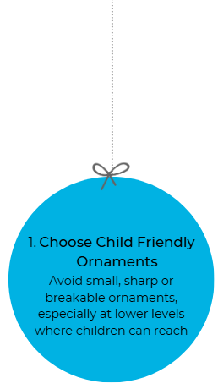

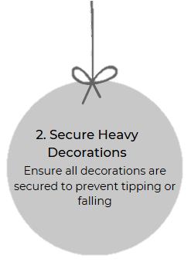
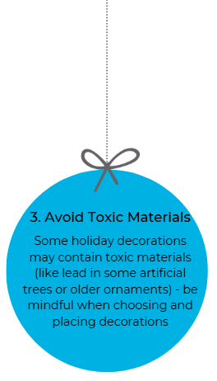

Ornaments & Decorations
Ensure the safety of your little ones by following these easy guidelines.

Slide 10

Fire Safety
Keep candles & open flames supervised
Check & water your tree to prevent it from drying out to reduce risk of it catching fire.
Keep matches and lighters out of children’s reach.
Inspect holiday lights for frayed wires, damaged bulbs. Avoid overloading outlets
Always turn off lights before going to bed or leaving the house

