Slide 1
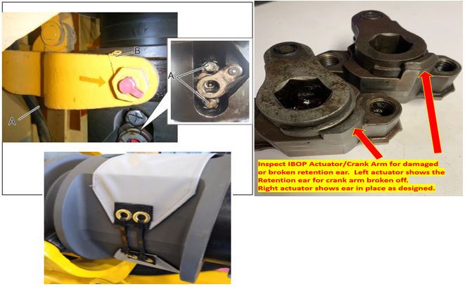

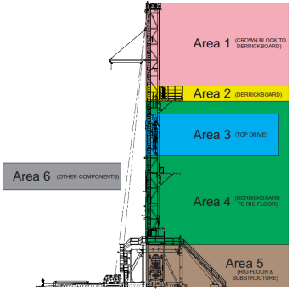
®
eSafe DROPS Inspections
Dropped objects continue to make up the most frequent SIF potential exposures O&G employees face at work. These exposures can and have led to SIF actual injuries in the past, but we do have the ability to control and remove many of these exposures. H&P’s DROPS program has been developed using years of dropped object data to control and remove potential dropped object exposures on the rig. The DROPS program, when followed correctly, can significantly reduce the likelihood of a SIF potential dropped object happening on your rig.
What to Look For
Items that have potential to break, unscrew, or otherwise fail from exposure to movement and vibration Items that have previously been found to be installed incorrectly or missing secondary retention The inspections allow a place to document items that are not called out specifically, but may have been identified as needing attention by the inspector
Inspection Areas
Scheduled inspections are broken down by area Area 1 – Crown down to derrick board Area 2 – Derrick board Area 3 – Top drive | Area 4 – Derrick board to rig floor Area 5 – Rig floor and substructure Area 6 – Other rig components
DROPS Frequency
Inspection frequency varies by component and task Scheduled inspections daily, weekly & annually Unscheduled inspections based on current operations, rough drilling, jarring & pre-mast raise
Corrective Action
Properly documenting inspections allows for timely follow-up to help ensure corrections are made and reduces repeat findings Tracking and trending of inspection findings allows for continuous improvement by using data from inspections over long periods of time and from multiple rigs
Examples

