Slide 1
Safety Moments
From H&P HSE

Slide 2
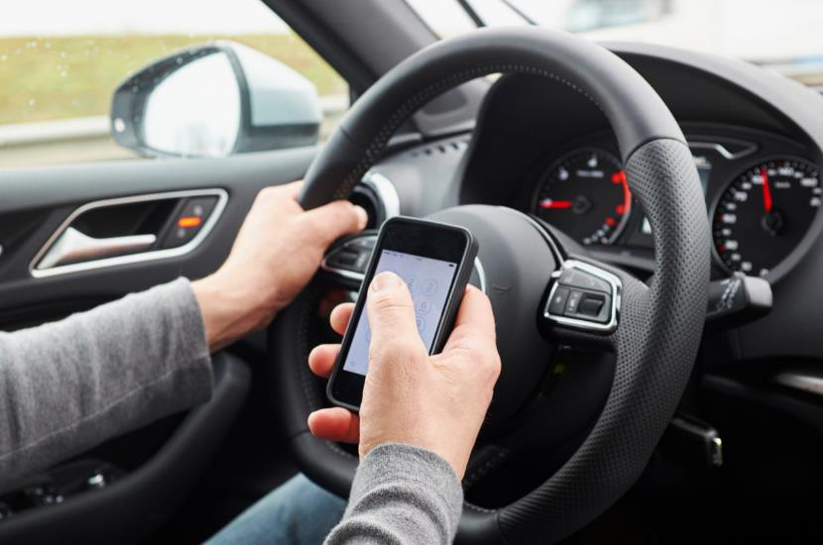
Driving Safety
Safe driving practices are essential for preventing accidents and ensuring road safety. Limiting distractions while driving is crucial to reducing the risk of collisions and protecting yourself and others on the road.
80% of crashes are the result of distracted driving and using a cell phone while driving makes you 4 times more likely to be involved in a collision.

Slide 3
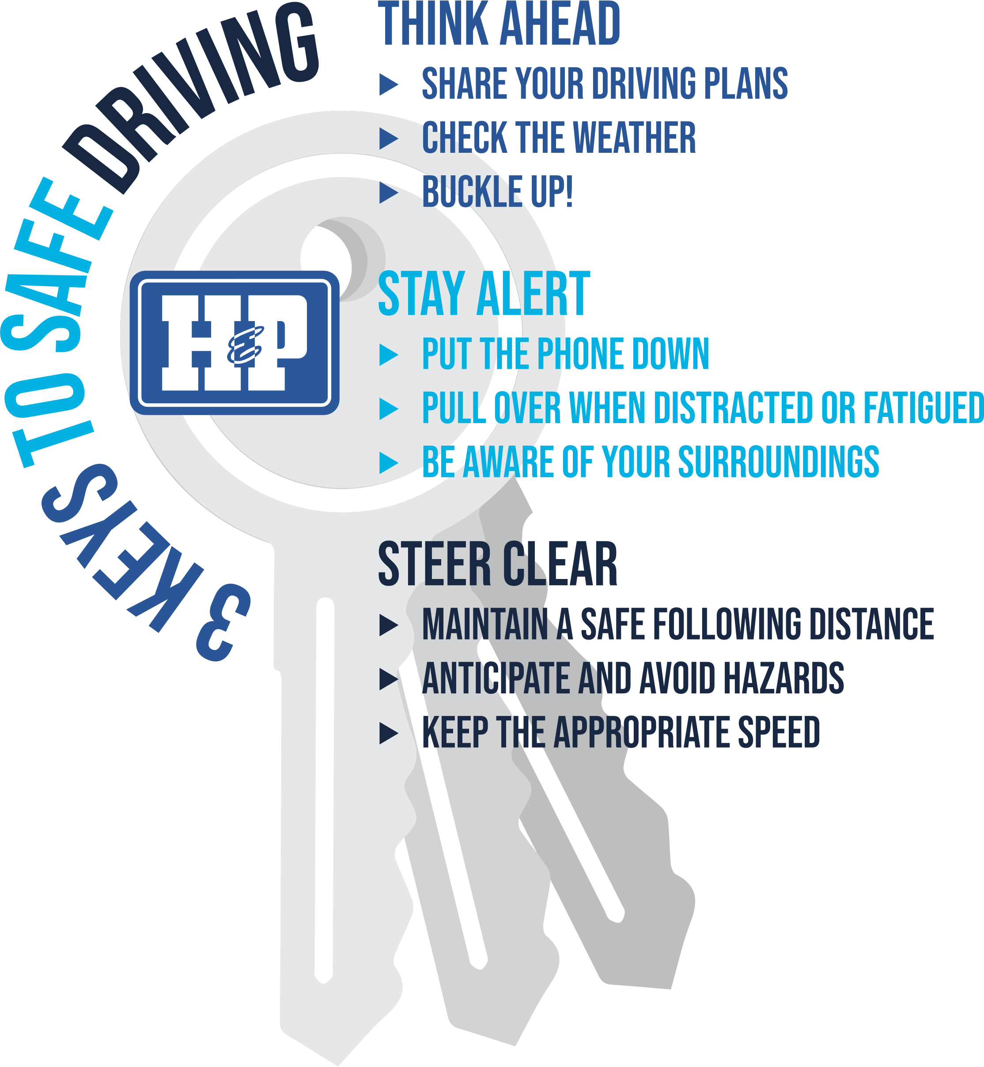
Remember
the 3 Keys to Safe Driving:

Slide 4
Tips and tricks to minimize distractions:
Silence your phone or turn on ‘Do Not Disturb’ before driving to mitigate the temptation to respond to texts or calls.
Start your navigation before you begin your journey and familiarize yourself with the route.
Keep your music volume low.
Place all bags, laptops and personal items out of reach.

Slide 5
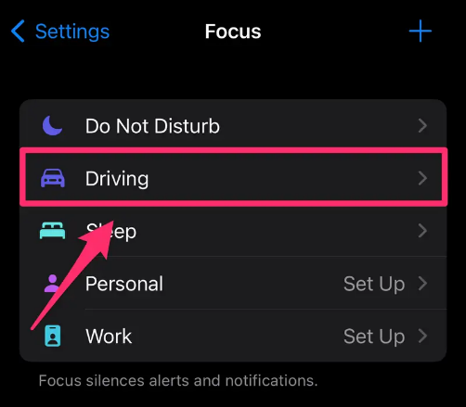
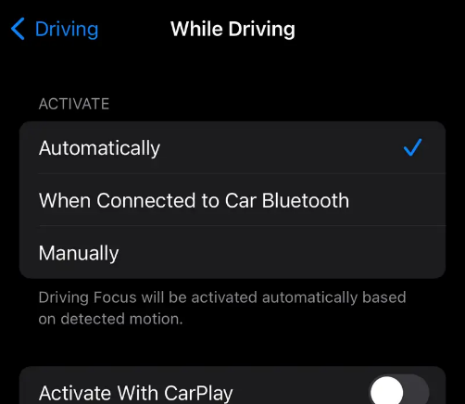
Sync your phone to your car to automatically activate Do Not Disturb/Driving Mode.
iPhone:
If you do not have this feature set up yet, go to Settings > Focus, tap the Add (+) button in the top right corner, then tap Driving.
Tap Customize Focus and follow on screen instructions.
To turn on Drive Focus automatically, Settings > Focus > Driving > While Driving and tap Automatically.

Slide 6
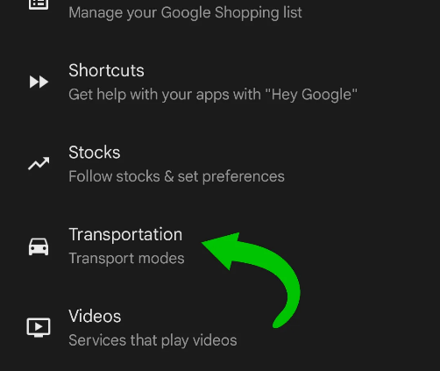
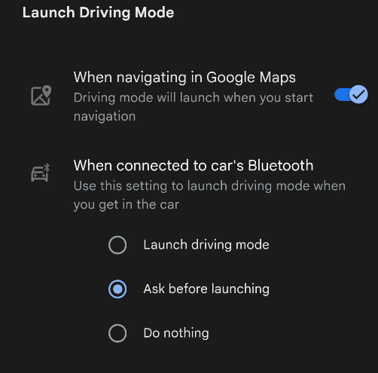


Sync your phone to your car to automatically activate Do Not Disturb/Driving Mode.
Android:
Head to Settings > Google > Settings for Google Apps > Search, Assistant & Voice > Google Assistant.
Find Transportation > Driving Mode.
You can now customize the Driving Mode feature with a variety of options. Choosing ‘Launch Driving Mode’ on your Android phone when connected to your car’s Bluetooth is a recommended Safe Driving best practice.

Slide 7
Additional links and resources on driving safety.
safe2save - get points for safe driving and redeem them at a variety of places.
motus - a safety solution for mobile workers on the road.
zendrive - personalized safe driving data that can earn you rewards.
https://www.kaileemillsfoundation.org/ - get involved and drive awareness

